Slide 1

3. Agile Principles and Mindset

Slide 2
Table of content
Introduction to Agile | 3
SCRUM | 12
KANBAN | 20
EXTREME PROGRAMMING (XP) | 25
LEAN SOFTWARE DEVELOPMENT | 29
AGILE LEADERSHIP | 33

Slide 3
Introduction to AGILE

Slide 4
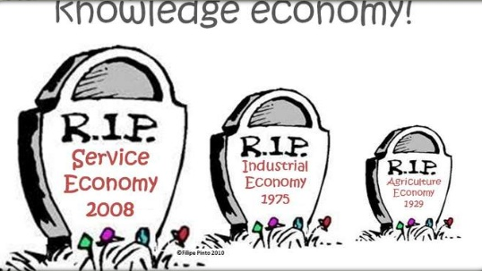
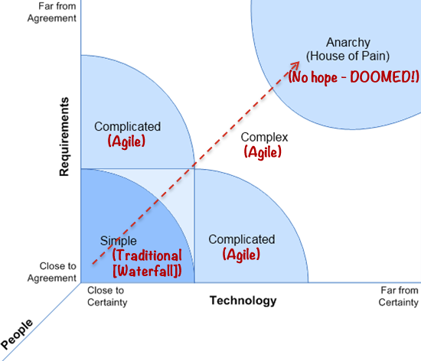
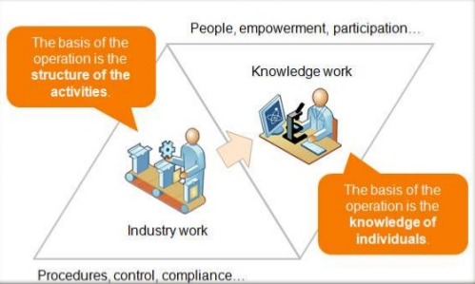
Why should we use Agile?

Slide 5
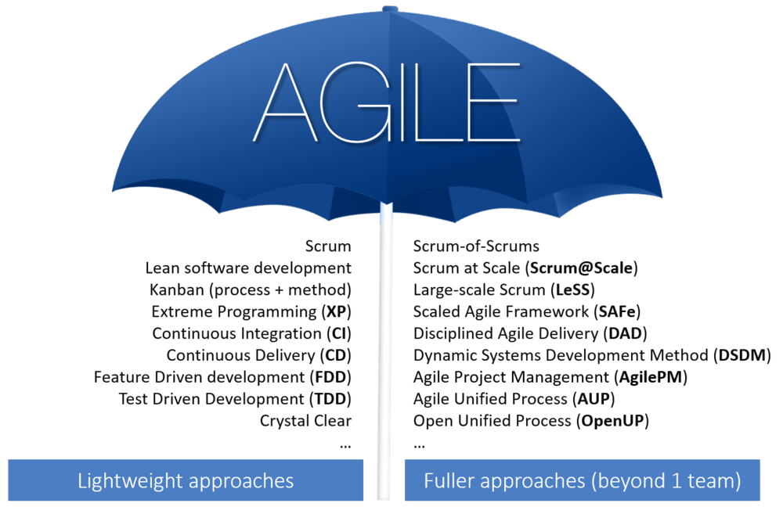
Introduction to Agile
Agile software development is an umbrella term for a set of frameworks and practices based on the values and principles expressed in the Manifesto for Agile Software Development and the 12 Principles behind it.

Slide 6
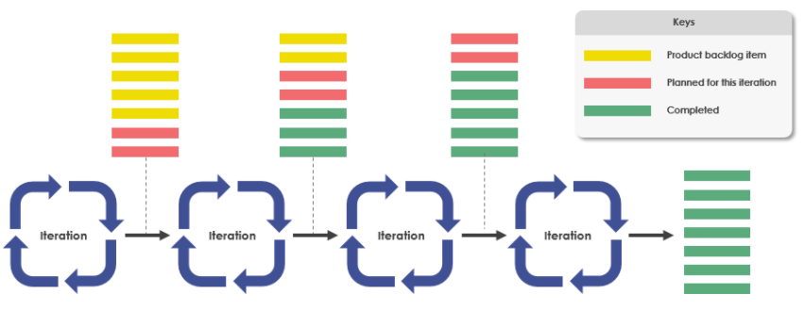
Agile characteristics
Iterative and incremental
Self-organizing and Cross-functional team

Slide 7
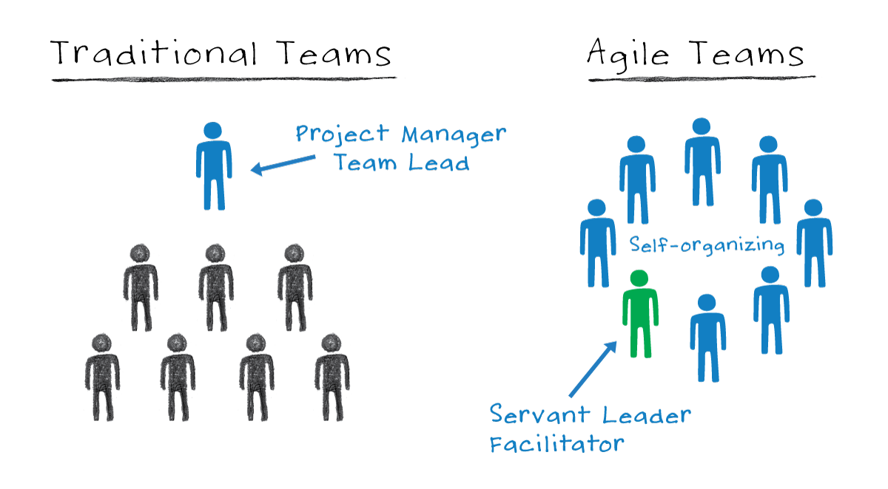
Agile characteristics
Iterative and incremental
Self-organizing and Cross-functional team

Slide 8
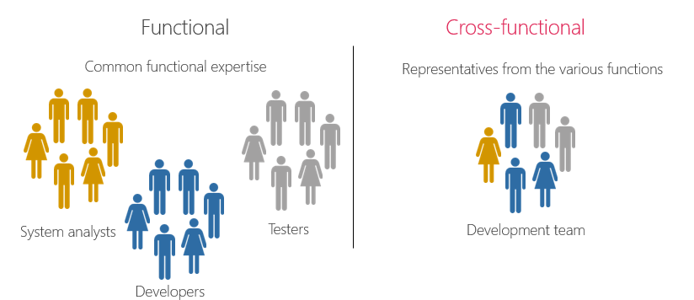
Agile characteristics
Iterative and incremental
Self-organizing and Cross-functional team

Slide 9
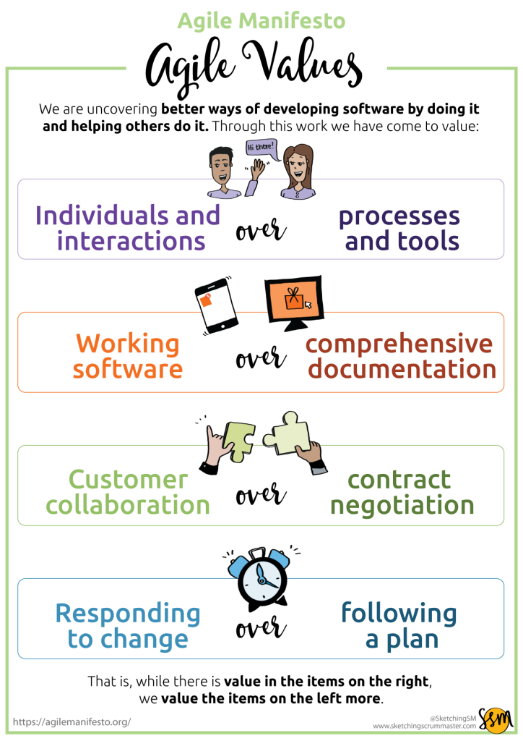
Agile Manifesto
The format A over B
Intention, focus and effort
Value based, people engagement
2. NOT Do A instead of B

Slide 10
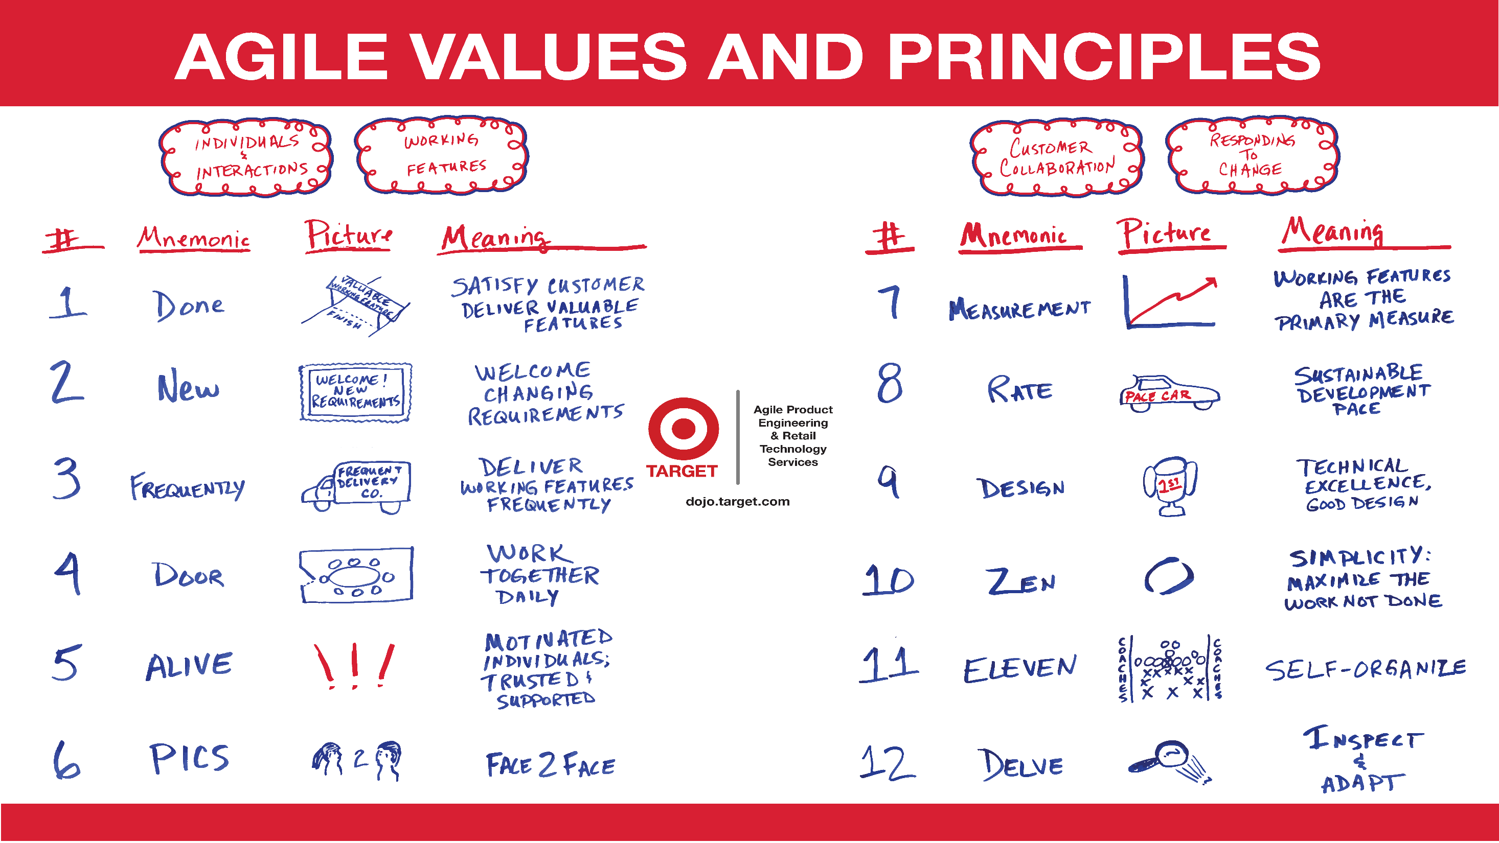

Slide 11
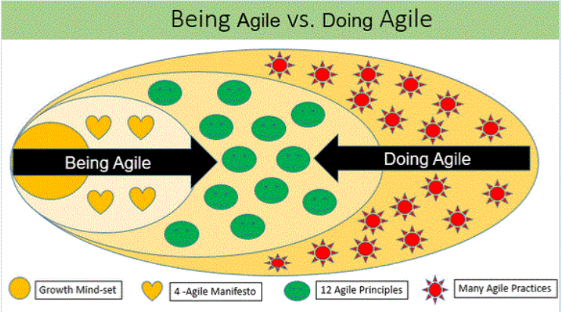
Being Agile vs Doing Agile
“Doing” Agile
An ineffective way to implement agile
Doing Agile involves using agile practices withourt embracing the agile mindset that allows us to understand how to select the right balance of practices and tailor them appropriately
“Being” Agile
The correct way to implement agile
Being Agile starts with internalizing agile mindset, then using that understanding to select and implement the correct practices, taloring them to different situations as needed

Slide 12
SCRUM

Slide 13
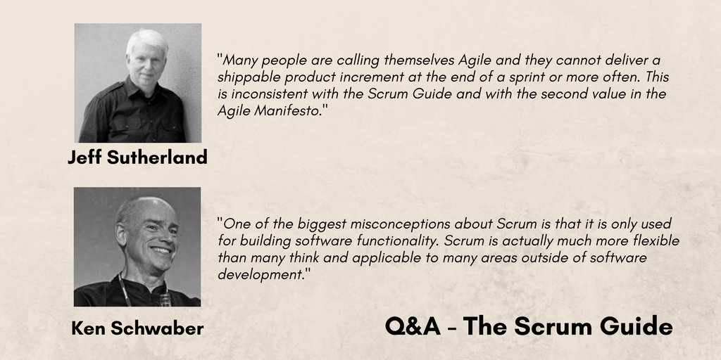
What is Scrum?
Scrum is a framework for developing, delivering, and sustaining complex products
This framework consists of Scrum’s roles, events, artifacts, and the rules that bind them together

Slide 14
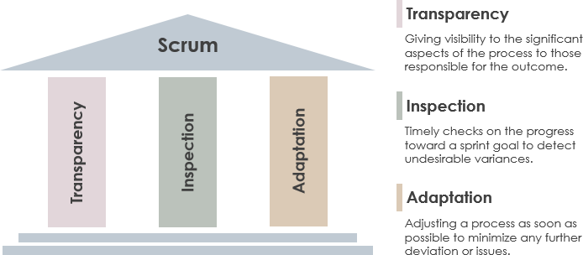
Scrum Pillars

Slide 15
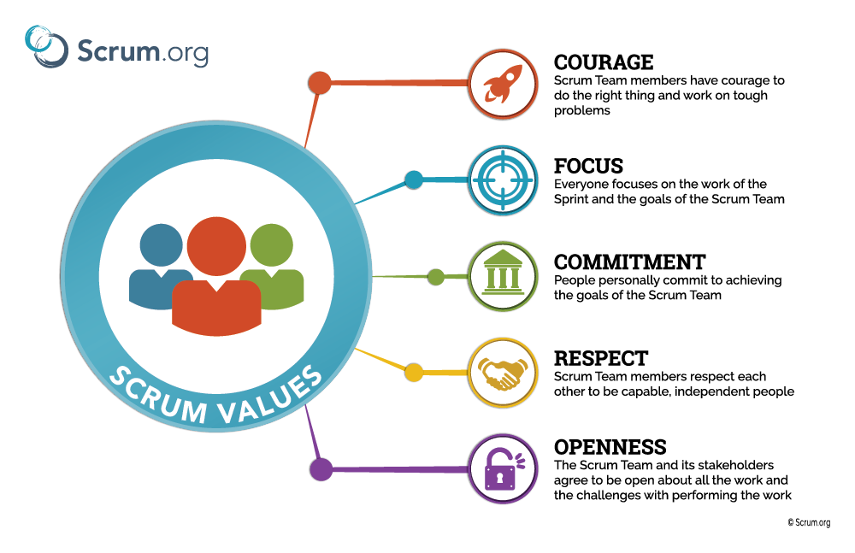
Scrum Values

Slide 16
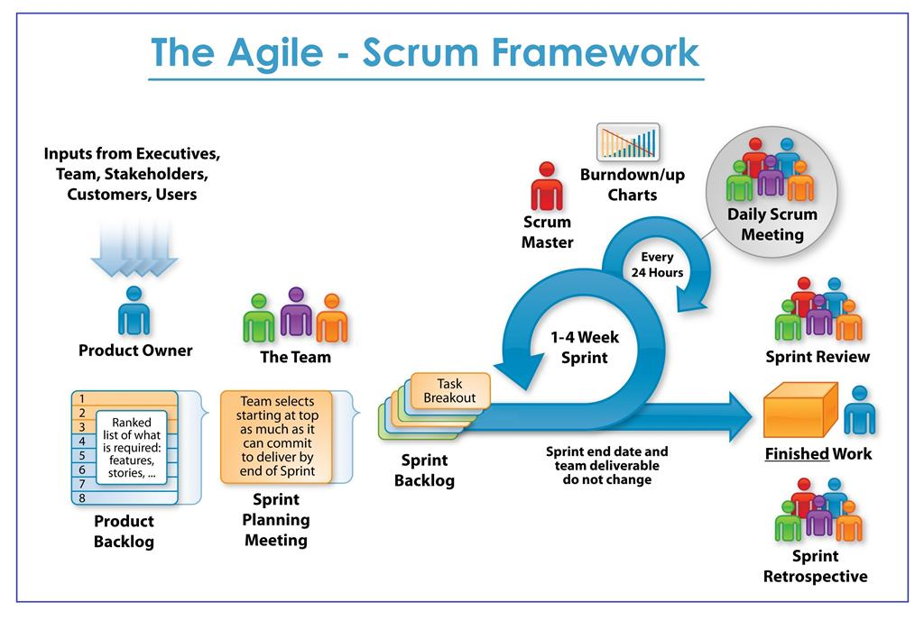

Slide 17
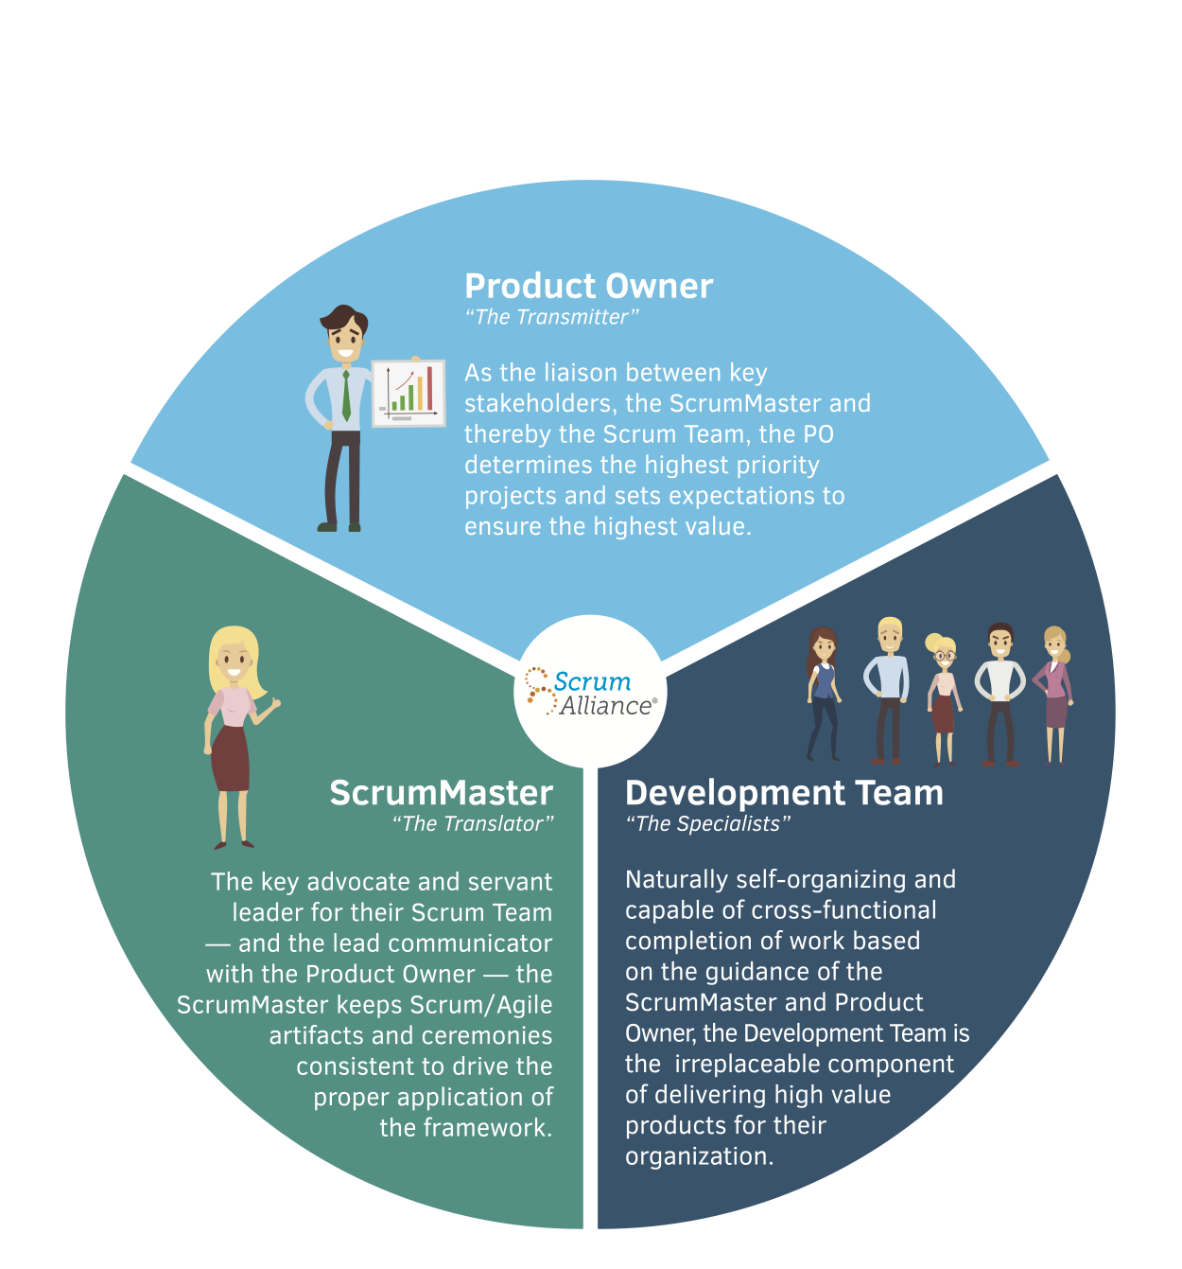
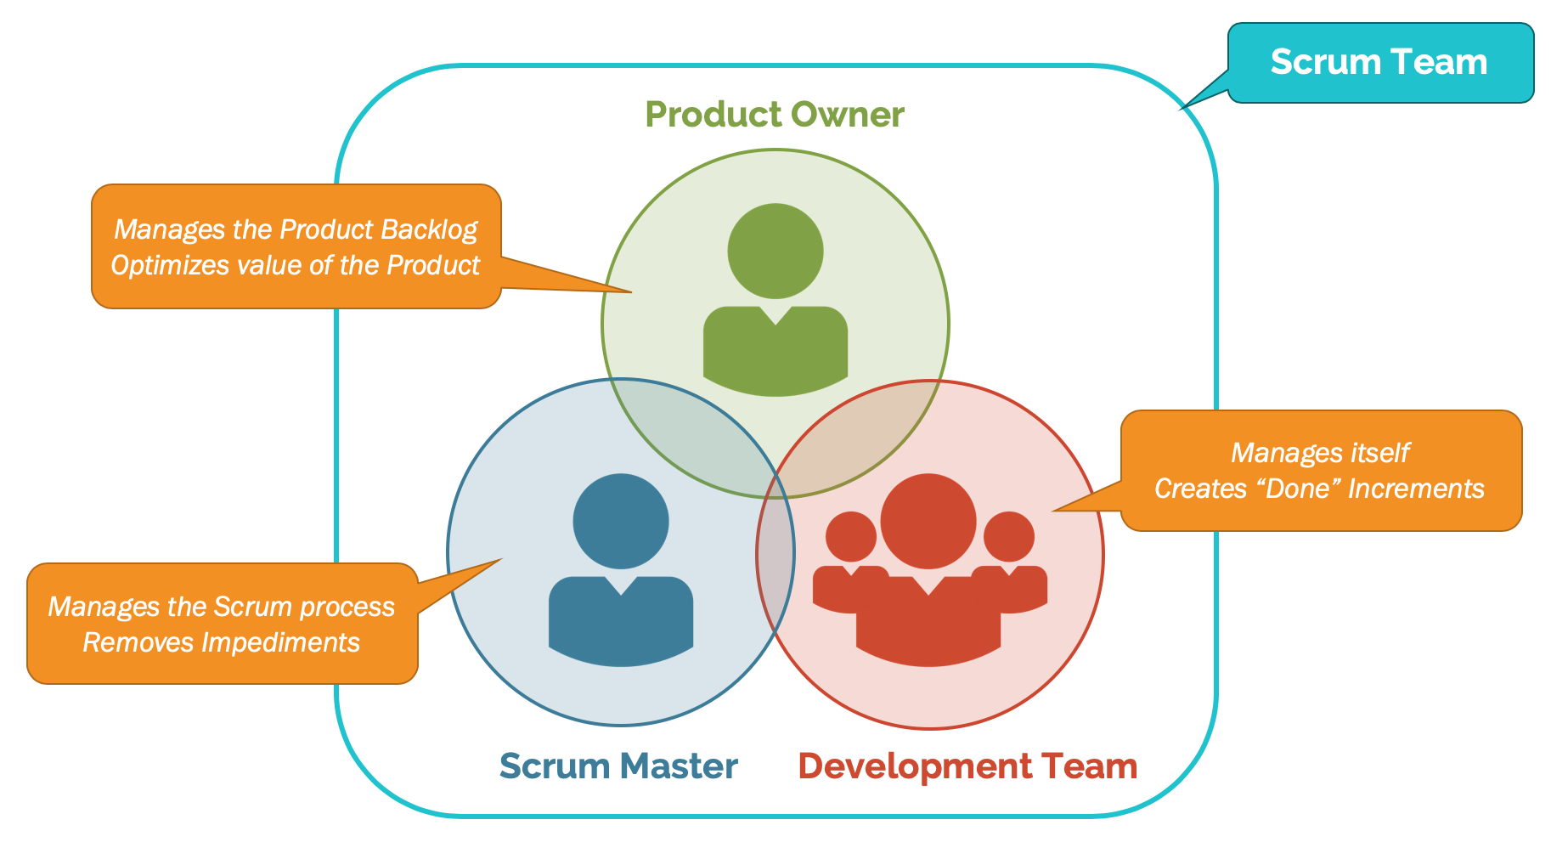
Scrum Team Roles

Slide 18
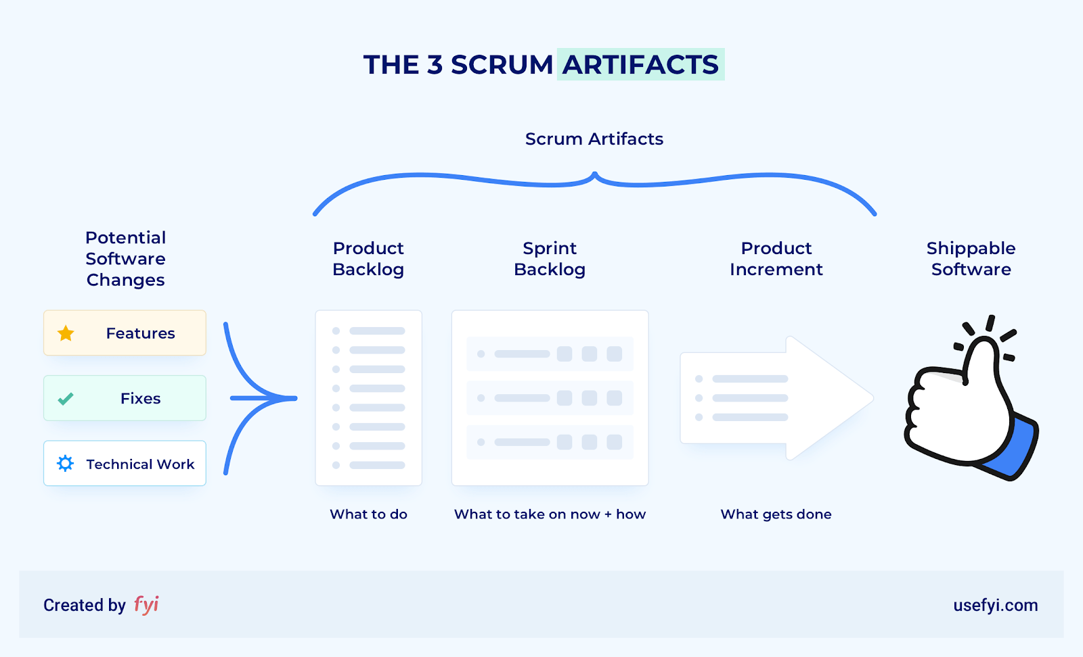
Scrum Artifacts

Slide 19
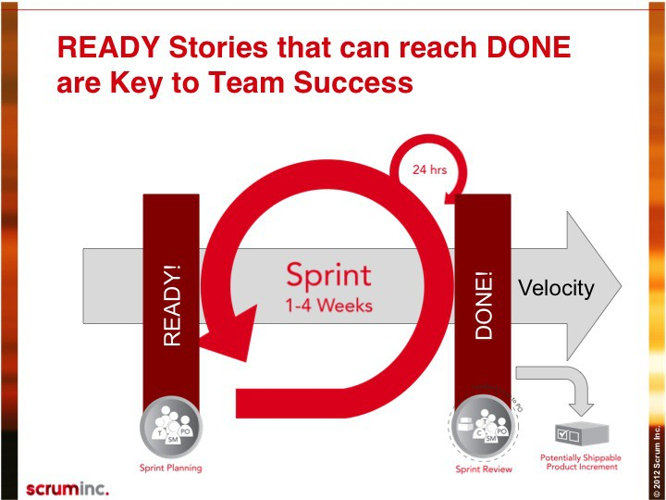
Definition of Ready and Definition of Done

Slide 20
KANBAN

Slide 21
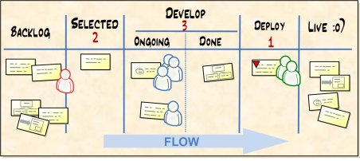
KANBAN
Kanban is a Japanese word that means “visual card”
At Toyota, Kanban is the term used for the visual and physical signaling system that ties together the whole Lean Production system

Slide 22
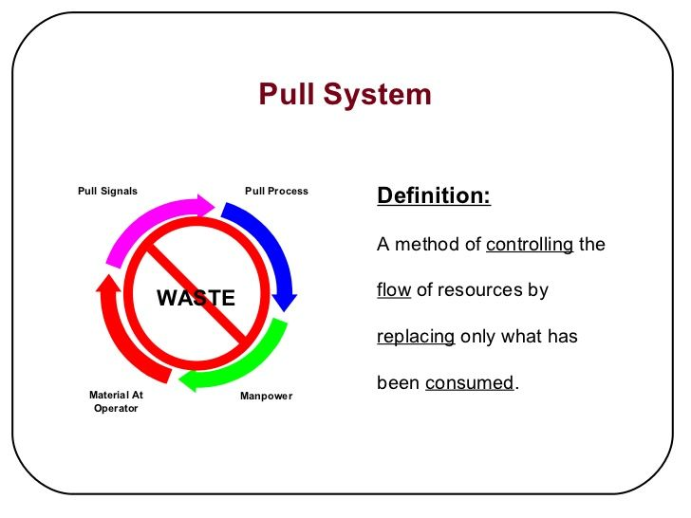
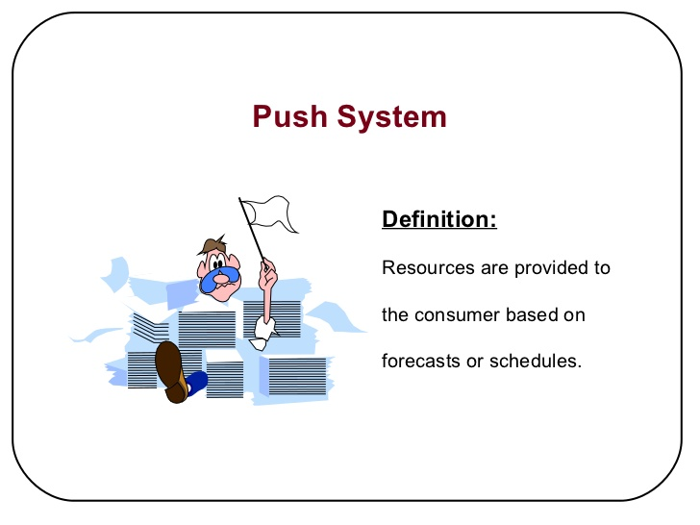
KANBAN Pull system

Slide 23
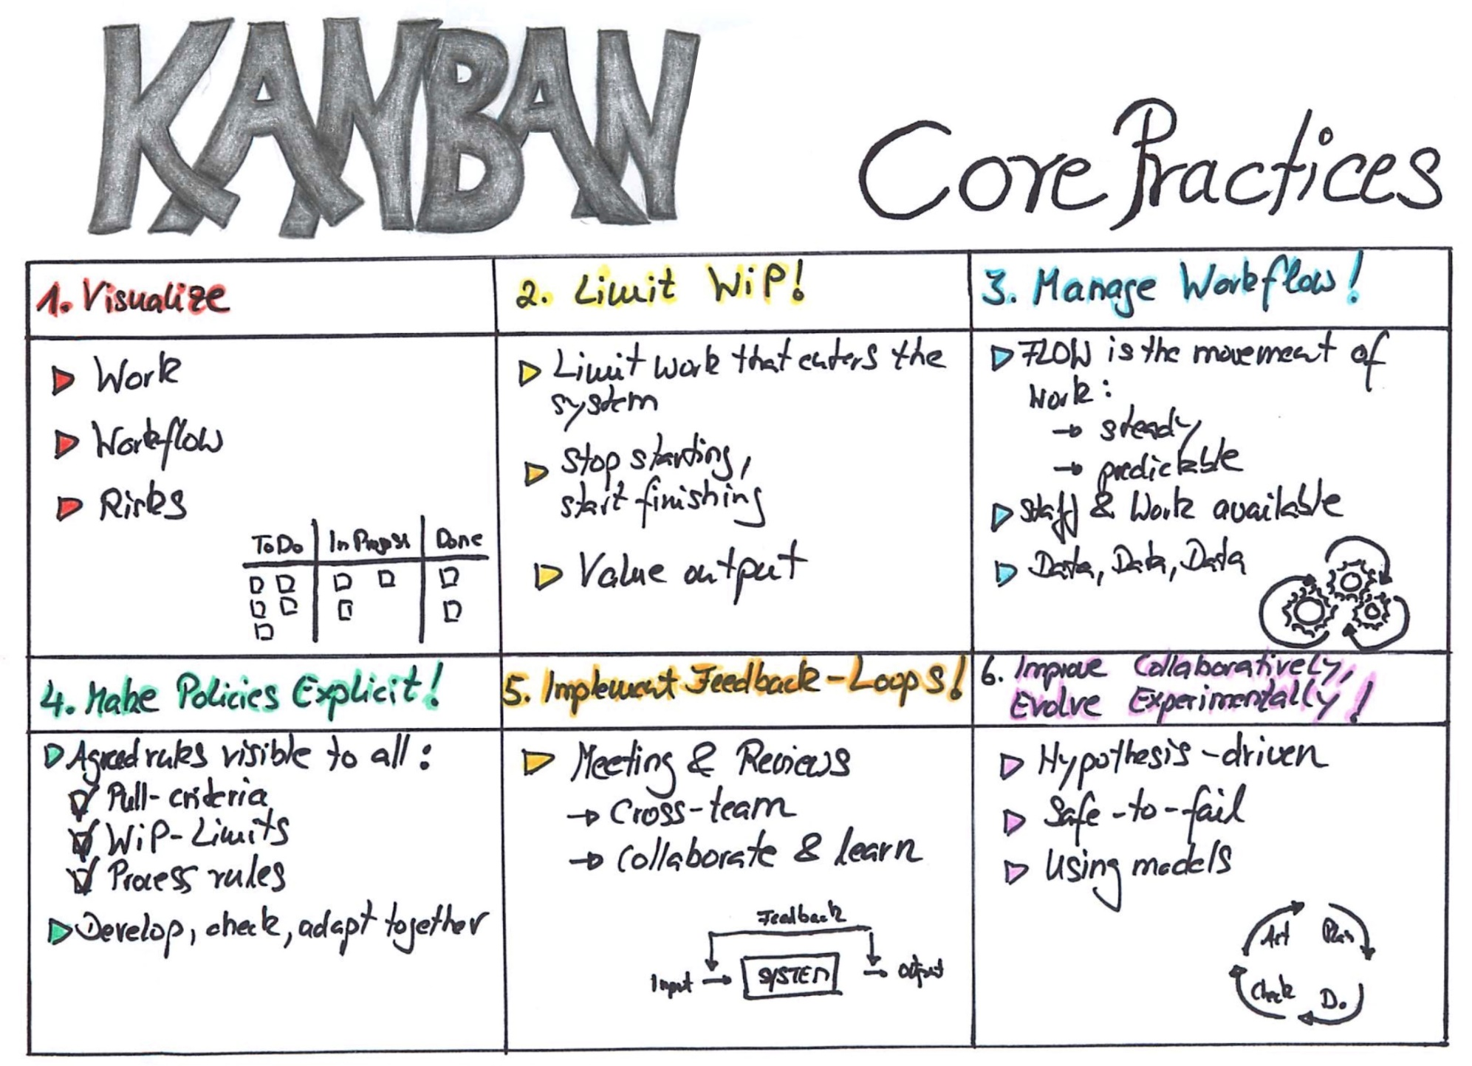

Slide 24
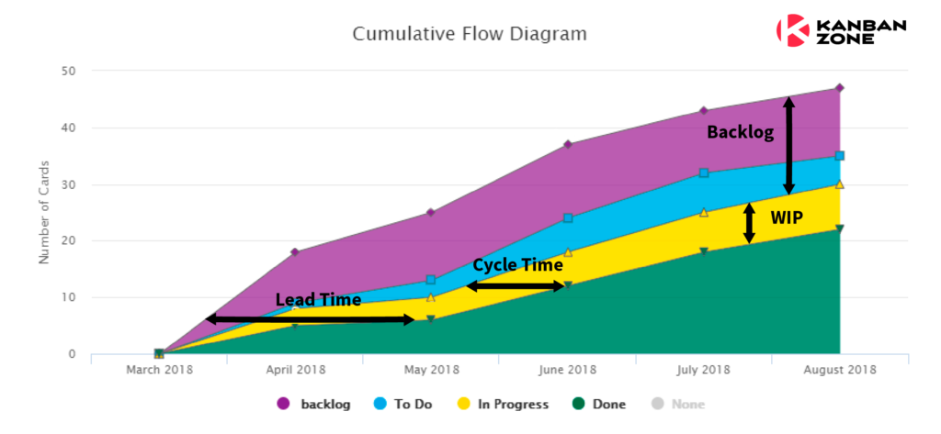
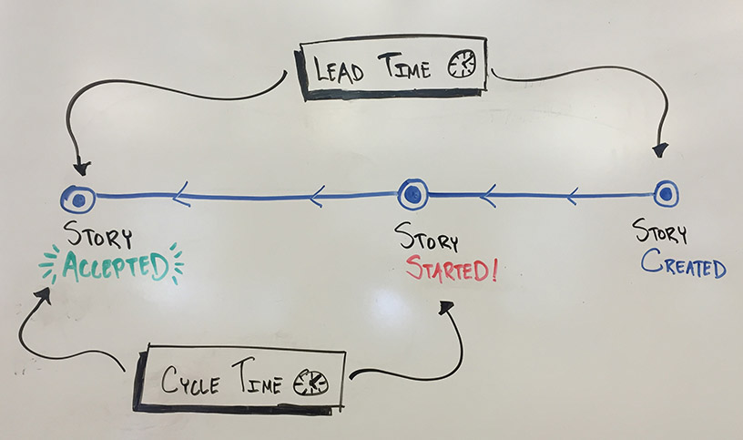
Lead and Cycle time

Slide 25
EXTREME PROGRAMMING (XP)

Slide 26
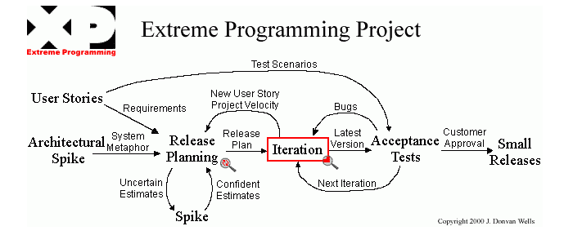
Extreme Programming (XP)
Extreme Programming (XP) is an agile software development framework that aims to produce higher quality software, and higher quality of life for the development team. XP is the most specific of the agile frameworks regarding appropriate engineering practices for software development.

Slide 27
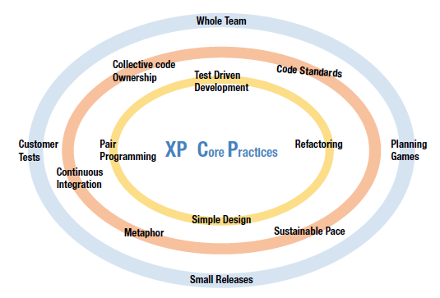
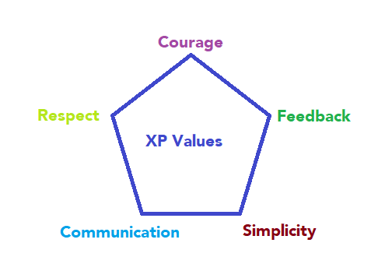
XP Core Values and Practices

Slide 28
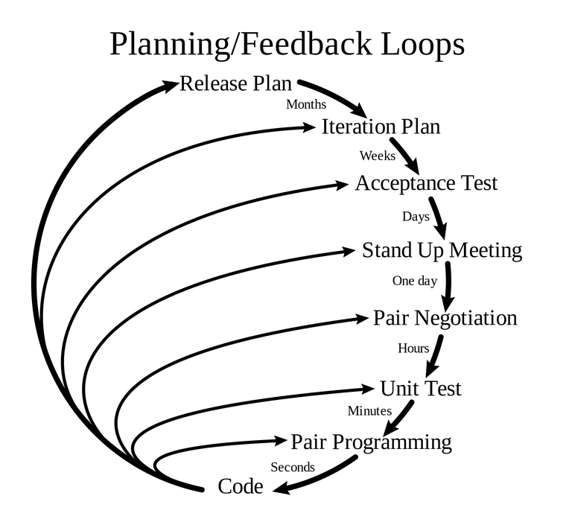
XP Team Roles
Customers
The client
Features to be included
Budget to be allocated
Priorities within the project
2. Programmers
The warriors of the team and do all the heavy lifting.
3. Tester
The qualifier provide quality assurance
4. Trackers
The sharp-shooters support team to work more efficiently.
Track their team’s progress and identify where the team can improve.
5. Coach
The supporter coaching the team with XP practice
They ensure that the team is using every XP practice correctly.

Slide 29
LEAN SOFTWARE DEVELOPMENT

Slide 30
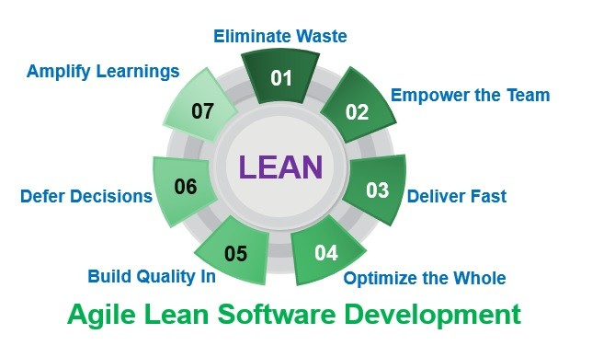
LEAN Product Development

Slide 31
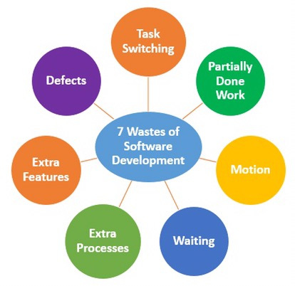
Seven wastes of Lean

Slide 32
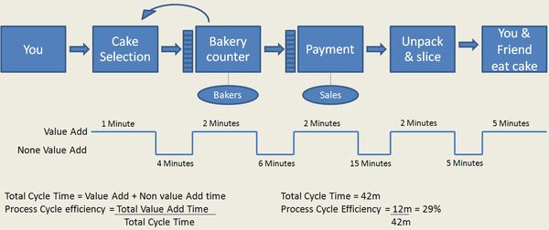
Value Stream Mapping

Slide 33
Agile Leadership

Slide 34
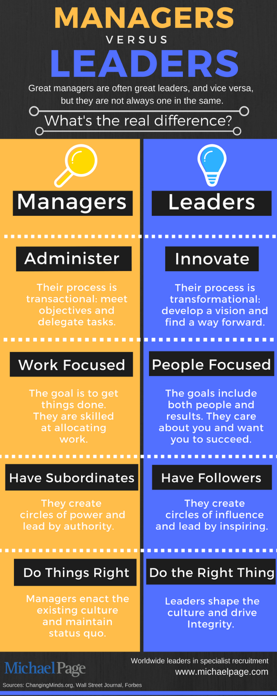
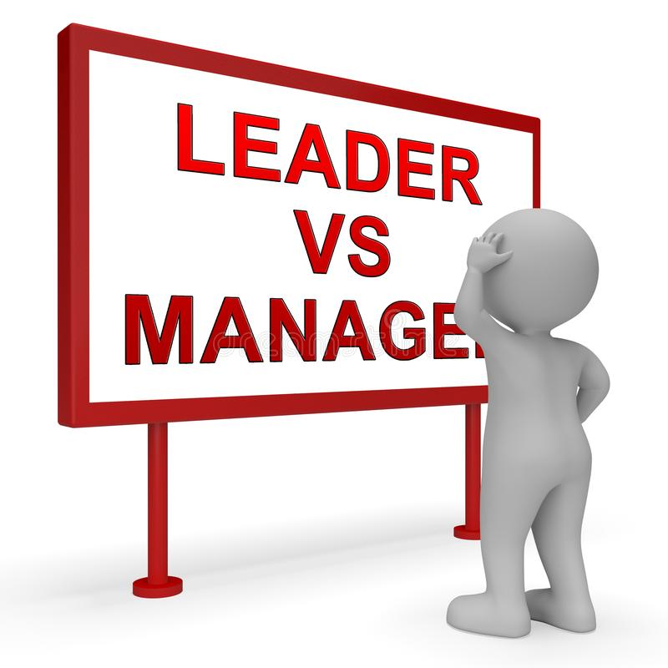
Management vs Leadership

Slide 35

Servant Leadership – 4 primary duties
1. Shield the team from interruption
2. Remove impediments to progress
3. Communicate (re-communicate) the product vision
4. Carry food and water

Slide 36
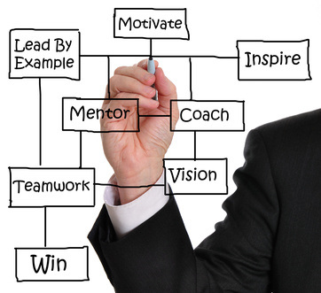
12 principles for leading agile projects
1) Learn the team members’ needs
2) Learn the project’s requirements
3) Act for the simultaneous welfare of the team and the project
4) Create an environment of functional accountability
5) Have a vision of the completed project
6) Use the project vision to drive your own behavior.
7) Serve as the central figure in successful project team development
8) Recognize team conflict as a positive step
9) Manage with an eye towards ethics
10) Remember that ethics is not an afterthought, but an integral part of our thinking
11) Take time to reflect on project
12) Develop the trick of thinking backwards

Slide 37

Agile Leadership Practices
1. Model Desired Behavior
2. Communicate the product vision
3. Enable Others to Act
4. Be Willing to Challenge the Quo
Forward looking
Inspiring
Competent
Honesty

Slide 38

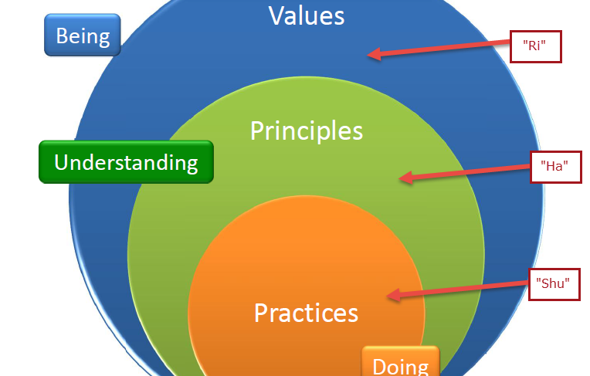
SUMMARY
Understand 4 Agile Value and 12 Agile Principles
Understand core values, principle and practices of
Scrum, Kanban, XP, Lean
Servant leadership

Slide 39
Domain II. Value-Driven Delivery

Slide 40
Domain II. Value-Driven Delivery
What & Why Value-Driven Delivery?
Assessing Value
Prioritizing Value
Delivering Incrementally
Agile Contracting
Verification & Validating Value
CI/ TDD/ ATDD

Slide 41
Tasks
1. Plan work incrementally. | 8. Refactor often.
2. Gain consensus on just-in-time acceptance criteria. | 9. Optimize environmental, operational, and infrastructure factors.
3. Tune process to organization, team, and project. | 10. Review and checkpoint often.
4. Release minimal viable products. | 11. Balance adding value and reducing risk.
5. Work in small batches. | 12. Reprioritize periodically to maximize value.
6. Review often. | 13. Prioritize nonfunctional requirements.
7. Prioritize work. | 14. Review and improve the overall process and product.

Slide 42
What & Why Value-Driven?

Slide 43
Agile Approach
Value driven - early and continuous delivery of value
Focus on people and interactions
Cross functional Self organizing teams
Agility is everyone’s Responsibility
Embrace changes even late in development
Working software as the primary measure of progress

Slide 44

Value-Driven Delivery
The reason projects are undertaken is to generate business value, be it to produce a benefit or improve a service.
Delivering value is the reason for doing projects, then value-driven delivery must be our focus throughout the project.
Notes:
The reason projects are undertaken is to generate business value, be it to produce a benefit or improve a service. Even safety and regulatory compliance projects can be expressed in terms of business value by considering the business risk and the impact of not undertaking them. So if delivering value is the reason for doing projects, then value-driven delivery must be our focus throughout the project.

Slide 45
Value Sample
Notes:
CXO

Slide 46
Value Sample

Slide 47
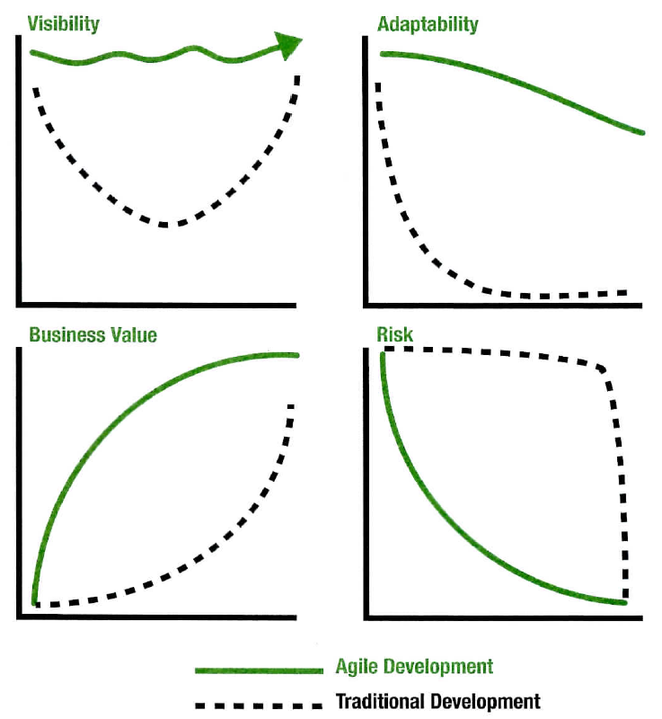
Agile Value Proposition

Slide 48

Delivery Value, by how?
Working software over comprehensive documentation
Deliver working software frequently
Working software is the primary measure of progress

Slide 49
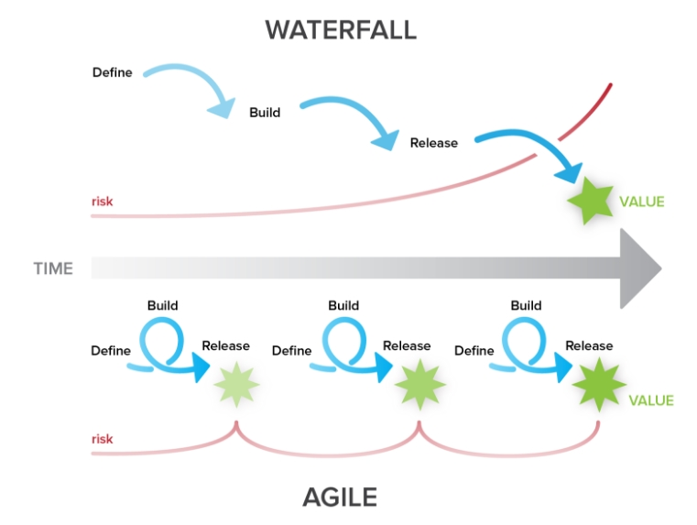
Delivery Value Early

Slide 50
Delivery Value Early
Deliver the highest-value portions of the project as soon as possible
The longer a project runs, the longer the horizon becomes for risks that can reduce value such as failure, decreased benefits, erosion of opportunities
To maximize success, we have to try to deliver as many high-value components as soon as we can, before things change or go sideways
Stakeholder satisfaction plays a huge role in project success
Engaged, committed sponsors and product owners are vital for removing project obstacles and declaring success.
By delivering high-value elements early, the team demonstrates an understanding of the stakeholders’ needs, shows that they recognize the most important aspects of the project, and proves they can deliver.
Tangible results help the team raise the confidence of stakeholders, build rapport with them, and get them on board early, creating a virtuous circle of support.
Value-driven delivery means making decisions that prioritize the value-adding activities and risk- reducing efforts for the project, and then executing based on these priorities

Slide 51
Minimize Waste
Wasteful activities reduce value
Poppendiecks’ list of seven wastes:
Partially done work
Extra processes
Extra features
Task switching
Waiting
Motion
Defects

Slide 52
Identify Waste
What’s lurking to do in the project?
Where are bottlenecks and time sucks?
Are team members pulled between activities?
What are you and the team waiting for?
What type of escaped defects have you experienced?

Slide 53
Prioritizing Value

Slide 54
Customer Valued Prioritization
Agile teams work on the items that yield the highest value to the customer first
The product owner is responsible for keeping items in the backlog prioritized by business value
When changes are added to backlog, they must be prioritized for value
The customer is the person who will declare what success looks like
The team will discuss with the customer at the end of each iteration the priority of the remaining

Slide 55
Prioritization Schemes
Simple Schemes
MoSCoW
Monopoly Money
100-Point Method
Dot Voting or Multi-Voting
Kano Analysis
Requirements Prioritization Model
Notes:
Simple Schemes: Pri 1, Pri 2, Pri 3, …
Monopoly Money: the amount of project budget & ask them to distribute those funds among important requirements

Slide 56
Prioritization Schemes - MoSCoW

Slide 57
Prioritization Schemes
Monopoly Money: the amount of project budget & ask them to distribute those funds among the system features
100-Point Method: each stakeholder is given 100 points that he/ she can use to vote for most important requirement
Dot Voting or Multi-Voting: each stakeholder gets a predetermined number of dots (or check marks, sticky stars, etc.) to distribute among the options presented.
Eg: When deciding how many votes to give each person, a good rule of thumb is 20 percent of the total number of items. So if there are 40 items to be voted on, we would calculate 40 x 0.2 = 8, and everyone would get 8 votes to distribute.

Slide 58
Prioritization Schemes – Kano Analysis

Slide 59
Requirements Prioritization Model
Created by Karl Wiegers
With this approach, the benefit, penalty, cost, and risk of every proposed feature is rated on a relative scale of 1 (lowest) to 9 (highest).
Customers rate both the benefit score for having the feature and the penalty score for not having it.
Developers rate both the cost of producing the feature and the risk associated with producing it
The numbers for each feature are then entered into a weighted formula that is used to calculate the relative priority of all the features.

Slide 60
Relative Prioritization/Ranking
End goal is understanding the priority of features
Great if we just simply asking the customer in order of relative priority

Slide 61
Delivering Incrementally

Slide 62
Delivery Incremental
Incremental delivery is another way that agile methods optimize the delivery of value
In the case of software development projects, team could delivery to production in increment
Incremental delivery reduces the amount of rework by finding issues earlier & thereby contributing to the delivery of value on the project

Slide 63
Minimal Viable Product (MVP)
The term “minimal viable product,“ or MVP (also known as “minimal marketable feature,” or MMF) refers to this package of functionality that is complete enough to be useful to the users or the market
Yet still small enough that it does not represent the entire project

Slide 64
Minimal Viable Product (MVP)

Slide 65
Agile Tooling
Agile team prefers low-tech, high-touch tools over sophisticated computerized method
One key reason agile team value these types of tools is that low-tech, tangible objects promote communication & collaboration
In keeping with the low-tech, high-touch approach, agile teams make widespread use of tangible tools such as task boards, user stories written on 3-by-5-inch index cards, and numbered card decks for planning poker sessions
Agile teams use low-tech, high-touch tools such as task boards as their primary method of tracking and reporting value

Slide 66
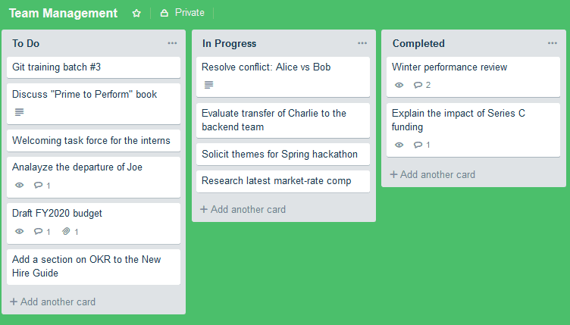
Task/Kanban Boards
They are the primary tool for planning and monitoring the progress of the work.
A task or Kanban board is generally a whiteboard with columns that show the various stages of work
The tasks that are being worked on are represented by sticky notes that team members move through the columns to show their progress

Slide 67
Verification & Validating Value

Slide 68
Verification & Validating Value

Slide 69
Verification & Validating Value
It is one thing to think we are building great products and services and another thing entirely to have the sponsors, users, or product owner confirm this
Agile methods are often used on projects that are intangible (such as designs, software, etc.).
The intangible nature of these end products means it is all that much more important to validate that what we are building is, in fact, on the right track and seen as highly valuable by the business

Slide 70
Frequent Verification & Validation
Agile techniques are designed to resolve problems as soon as possible, before they can grow bigger and move up the cost of change curve
Frequent verification and validation is practiced at many levels on agile projects
With frequent verification and validation, we are checking to make sure things are working and progressing as they should, as well as looking for any mismatches in expectations

Slide 71
Frequent Verification & Validation

Slide 72
Testing and Verification in Software Development
Agile software projects automate as many of their tests as possible, which removes the human element from their execution.
Automation also allows the tests to be run more frequently at a lower cost
The goal of frequent verification and validation is to find issues as soon as possible and keep them low on the cost of change curve

Slide 73
Testing and Verification in Software Development
Exploratory and Usability Testing
Exploratory testing
Differs from scripted testing that attempts to exercise all the functional components of a system
Relies on the tester’s autonomy, skill, and creativity in trying to discover issues and unexpected behaviour.
Usability testing
Attempts to answer the question, “How will an end user respond to the system under realistic conditions?”
diagnose how easy it is to use the system, and help uncover where there are problems that might need redesign or changes
This typically involves observing users as they interact with the system for the first time.
Continuous Integration
Frequently incorporate new and changed code into their project code repository.
This helps minimize the integration problems that result from multiple people making incompatible changes to the same code base
The more frequently we make these code commits, the smaller the amount of code that needs to be changed to allow a new build (or version) of the software to compile successfully

Slide 74
Stakeholder Engagement

Slide 75
Domain III. Stakeholder Engagement
Taking Care of Stakeholders
Establishing a Shared Vision
Communicating with Stakeholders
Working Collaboratively
Using Critical Interpersonal Skills

Slide 76
Key Topics

Slide 77
Tasks
Engage empowered business stakeholders.
Share information frequently with all stakeholders.
Form working agreements for participation.
Assess organizational changes to maintain stakeholder engagement.
Use collaborative decision making and conflict resolution.
Establish a shared vision to align stakeholders.
Maintain a shared understanding of success.
Provide transparency for better decisions.
Balance certainty and adaptability for better planning.

Slide 78
Taking Care of Stakeholders

Slide 79
Stakeholders
Stakeholders, as defined in the PMBOK® Guide, are any people or groups who will be impacted by or have an impact on the project
Includes the customers, sponsors, and business representatives, as well as the project leaders, development team, vendors, and other people inside or outside of the organization who will be affected by the project or its results, including the products end users.
Getting stakeholders involved—in other words, engaging them in the project—is essential for the success of any project.

Slide 80
Identify all the stakeholders
Educating stakeholder about Agile
Keeping stakeholders engaged
Incorporating stakeholder value
Principles of stakeholder engagement

Slide 81
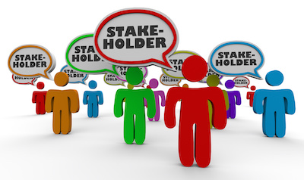
Identify all the stakeholders
Sponsors, users, and functional managers => easy to identify
Auditors, upstream providers of project inputs, or downstream consumers of project outputs => trickier to identify

Slide 82
Educating stakeholder about Agile
If the project stakeholders are new to agile methods, they may need some basic education about how agile projects operate
This education should include the goals, values, practices, and benefits of the agile approach to help them understand why the project will be executed in this manner.

Slide 83
Educating stakeholder about Agile
Recognize some of the concerns:
Executives and project sponsors: Executives and sponsors are often concerned about the risk of failure due to the use of unprecedented practices and counterintuitive planning approaches, even though an agile approach actually provides better feedback loops for preventing failure.
Managers: Managers may fear a loss of control or erosion of their role when projects assume an agile approach.
The development team: The development team may resist agile methods if they feel that this new approach is being forced upon them by management.
The user community: The user community is often worried they will not get all features they want or require, or that the early iterations will result in poor quality deliverables.
Supporting groups: Other groups maybe concerned about an apparent lack of control, continual requests for their involvement, or the lack of a clear end point.

Slide 84
Keeping stakeholders engaged
Continuing to engage them in the project as it progresses.
One benefit of short iterations is that they prevent stakeholders from losing interest in the process
One key reason to keep stakeholders engaged is to ensure we will hear about change requests as soon as possible
An ongoing dialogue with our stakeholders will also help us identify potential risks, defects, and issues.
One point to keep in mind when engaging stakeholders in project events is that not all stakeholders can be handled in the same way
Another aspect of stakeholder stewardship is establishing a process for escalating issues that need a high level of authority to resolve

Slide 85
Incorporating stakeholder value
Agile methods emphasize incorporating the sponsors’ and users’ priorities into the project’s priorities and execution
Incorporating stakeholder values means making sure we do not plan or initiate work that the stakeholders don’t support or value at this time.
The most important way that agile incorporates stakeholder values into a project is by engaging the product owner in the prioritization of the backlog
Another way to incorporate stakeholder values and interests into the project activities is to invite stakeholders to planning meetings and retrospectives
At the end of the day, it is the customers and sponsors who will determine whether our project is a success or a failure, so it is smart to plan our work and actions according to their values.

Slide 86
Principles of stakeholder engagement
Get the right stakeholders
Cement stakeholder involvement.
Actively manage stakeholder interest.
Frequently discuss what “done” looks like.
Show progress and capabilities.
Candidly discuss estimates and projections.

Slide 87
Establishing a Shared Vision

Slide 88
Establishing a Shared Vision
Agile Chartering
Definition of “Done”
Agile Modelling
Wireframes
Personas

Slide 89
Agile Chartering
The project charter is one of the first documents produced for a project.
It describes the project s goal, purpose, composition, and approach, and it provides authorization from the sponsor for the project to proceed.
Agile charters can range from very lightweight worksheets and barely expanded vision statements to detailed documents.
Non-Agile Charter | Agile Charter
High level Gain agreement about the project's W5H attributes (Who, What, Where, When, Why, and How) Obtain the authority to proceed
Focus: What will be built? | Focus: How the project will be run?

Slide 90
Agile Chartering
An agile charter will typically answer a subset (or all) of the following W5H questions:
Who will be engaged?—A list of the project participants and involved stakeholders
What is this project about?—A high-level description of the projects vision, mission, goals, and objectives
Where will it occur?—Details of work sites, deployment requirements, etc.
When will it start and end?—The project start and target end dates
Why is it being undertaken?—The business rationale for the project
How will it be undertaken?—A description of the approach (This is particularly important if agile methods are new to the organization or if changes from the standard approach, such as the increased involvement of the customer, need to be explained.)

Slide 91
Agile Chartering
For project managers who want to become agile project leaders, the "Learning to Lead Agile Teams" class is a three-day course that takes participants through a comprehensive agile development life cycle, incorporating real case studies and hands-on exercises. Unlike agile courses from generic training organizations, we only use instructors with hands-on agile project experience to ensure they can answer all your questions, and our supplementary materials include valuable tools, case studies and cheat sheets.

Slide 92
Definition of “Done”
Creating a shared definition of done is crucial for satisfying our stakeholders’ expectations.
A shared definition of done is necessary at every level of an agile project, including:
User stories: “For this story, done will mean developed, documented, and user acceptance tested.”
Releases: “The first release will be deemed done when system Alpha is replaced and there are no Priority 1 defects or change requests.”
Final project deliverables: “Done for the project will mean all high- and medium-priority features are implemented, there are two months of trouble-free operation, and the project receives satisfaction scores of greater than 70 percent from the user community.”

Slide 93
Agile Modeling
The term “agile modeling” refers to the various modeling techniques that are commonly used on agile projects.
While models are important in agile methods, their main value often lies in the discussion and creation of the model, rather than the final output.
As a reflection of this, agile models are often sketched on whiteboards and then photographed as a means of recording them
The types of agile models that can be created during agile modeling include:
Use case diagrams
Data models
Screen designs

Slide 94
Agile Modeling
Sample Use Case Diagram
Sample Data Model

Slide 95
Agile Modeling
Sample Screen Design

Slide 96
Wireframes
Wireframes are a popular way of creating a quick mock-up of a product.
For example, in software development, a wireframe depicts individual screens and the flows between the screens, as shown below.
Notes:
This diagram helps confirm that everyone has the same understanding of the product

Slide 97
Personas
Personas are quick guides or reminders of the key stakeholders on the project and their interests
Personas should:
Provide an archetypal description of users
Be grounded in reality
Be goal-oriented, specific, and relevant
Be tangible and actionable
Generate focus

Slide 98
Communicating With Stakeholders

Slide 99
Communicating with Stakeholders
Its critical for agile stakeholders to communicate frequently to ensure that everyone is on the same page and kept up to date, since many project failures can be traced back to a failure of communication
Agile communication
Face-to-face
Two- way communication
Knowledge sharing
Information radiators
Social media

Slide 100
Face-to-face
Face-to-face encounters have the highest bandwidth of all forms of communication
They transfer the most information in a given period of time.
Unlike static methods of communication, such as written reports, they provide opportunities for interactivity in real time
Effectiveness of Different Communication Channels

Slide 101
Two- way communication
Two-way transfers of information
For example, when discussing the goals for a sprint, the product owner or business representative should not only ask the development team for their confirmation, ideas, risks, and concerns, but actually listen to what they have to say and take it into account. There’s a good chance that the team members have valuable information that cant be accessed in any other way.

Slide 102
Knowledge sharing
Knowledge sharing is a key component of agile methods
Agile project aims to share information and make it available to everyone who might want to consume it, rather than hoarding it to secure our jobs or increase our project stature
It’s better to share information than to hoard it because the more people who know about something, the more people there will be who can help you when you get stuck
Information is shared throughout the team, it greatly reduces the risk of taking a hit to team productivity if the one person with key knowledge leaves the team

Slide 103
Agile Practices Promote Knowledge Sharing
Agile knowledge sharing happens at many levels, in both obvious and subtle ways
The agile emphasis on collaborative agile planning, estimating, and retrospectives allows everyone on the team to be exposed to key project information, instead of just funnelling it through one or two people

Slide 104
Information radiators
Highly visible displays of information; including large charts; graphs, and summaries of project data
These tools, sometimes referred to as “visual controls,” are usually displayed in high-traffic areas to maximize exposure, where they can quickly inform stakeholders about the project's status
The sort of data that might be displayed on an information radiator includes:
The features delivered to date versus the features remaining to be delivered
Who is working on what
The features selected for the current iteration
Velocity and defect metrics
Retrospective findings
List of threats and issues
Story maps
Burn charts

Slide 105

Social media

